Slide 1

SQL
Part 6. Detailed discussion of the operator JOIN

Slide 2
Different connection options in SQL

Slide 3
Different Ways to Join Rows in SQL
Join operator returns records formed from rows of two tables - left and right.
For the join of R1(a, b, x) and R2(c, d), the resulting schema will look like this:
R(a, b, x, c, d)
For R1(a, b), R2(c, d) and R3(x, z), the result of applying the join R1 join R2 join R3 will be formed a table with the scheme
R(a, b, c, d, x, z)

Slide 4
Different Ways to Join Rows in SQL
Cartesian product Inner join Outer join
Semi join
Anti join

Slide 5
Different Ways to Join Rows in SQL
The join operation can use any fields, not just those participating in the foreign key constraint
The same table can participate in the join multiple times under different names. In this case, you need to use aliases

Slide 6
Different Ways to Join Rows in SQL
Cartesian product
All possible combinations of rows of the left and right table. CROSS JOIN in FROM or several tables in FROM without a joining condition in WHERE
Inner join Outer join
Semi join
Anti join

Slide 7
Different Ways to Join Rows in SQL
Cartesian product
Inner join
Rows from the left and right tables for which the specified condition is met. INNER JOIN, or simply JOIN. You can specify the condition inside WHERE
Outer join
Semi join
Anti join

Slide 8
Different Ways to Join Rows in SQL
Cartesian product
Inner join
Outer join The union of the result of an inner join and an append made up of combinations of rows from one table and a row filled with NULL values:
LEFT [OUTER] JOIN. All other records from the left table
RIGHT [OUTER] JOIN. All other records from the right table
FULL [OUTER] JOIN. All other records from both tables
Semi join
Anti join

Slide 9
Different Ways to Join Rows in SQL
Cartesian product
Inner join
Outer join
Semi join (in another presentation)
The operation returns the records of a table if they are joined to the records of another table according to a given condition. And we don't give back records of another table.
Can be implemented in SQL using INNER JOIN or as a subquery in WHERE EXISTS or WHERE IN
Anti join

Slide 10
Different Ways to Join Rows in SQL
Cartesian product
Inner join
Outer join
Semi join
Anti join (in another presentation)
The opposite of a semi join. This operation finds unmatched records.
The operation can be implemented using an outer join or subqueries in WHERE NOT EXISTS or WHERE NOT IN

Slide 11
Inner join and Cartesian product

Slide 12
Result of Cartesian product (cross join)
Given two tables
Table A contains X records
Table B contains Y records
SELECT * from A cross join B;
SELECT * from A, B;
Cross join will return all possible pairs of records from tables A and B

Slide 13
Result of Cartesian product (cross join)
Given two tables
Table A contains X records
Table B contains Y records
SELECT * from A cross join B;
SELECT * from A, B;
Cross join will return all possible pairs of records from tables A and B
The number of rows in the query result is X * Y

Slide 14
The join operator cannot return more records than the Cartesian product

Slide 15
Inner Join
select * from A INNER JOIN B on a1 = b1
A
An inner join returns concatenated pairs of rows from A and B for which the condition a1 = b1 is true.
a1 | a2
1 | 3
2 | 4
Result
a1 | a2 | b1 | b2 | b3
1 | 3 | 1 | 3 | 6
1 | 3 | 1 | 4 | 7
1 | 3 | 1 | 11 | 12
B
b1 | b2 | b3
1 | 3 | 6
1 | 4 | 7
10 | 5 | 8
1 | 11 | 12

Slide 16
Inner Join
select * from A INNER JOIN B on a1 = b1
A
An inner join returns concatenated pairs of rows from A and B for which the condition a1 = b1 is true.
a1 | a2
1 | 3
2 | 4
Result
a1 | a2 | b1 | b2 | b3
1 | 3 | 1 | 3 | 6
1 | 3 | 1 | 4 | 7
1 | 3 | 1 | 11 | 12
B
b1 | b2 | b3
1 | 3 | 6
1 | 4 | 7
10 | 5 | 8
1 | 11 | 12
If a1 IS NULL and b1 IS NULL , then the condition a1 = b1 will not work, since NULL <> NULL

Slide 17
Inner Join
select * from A INNER JOIN B on a1 = b1
A
a1 | a2
1 | 3
2 | 4
Result
a1 | a2 | b1 | b2 | b3
1 | 3 | 1 | 3 | 6
1 | 3 | 1 | 4 | 7
1 | 3 | 1 | 11 | 12
B
b1 | b2 | b3
1 | 3 | 6
1 | 4 | 7
10 | 5 | 8
1 | 11 | 12

Slide 18
Join Algorithms in Postgres
Postgres supports three join algorithm options:
Nested loop
Hash join
Merge join

Slide 19
Nested loop
SELECT ... FROM A join B on A.x = B.y
Simple and obvious algorithm
In a loop, go through all the rows of table A
For each row a_n of A, in a loop, go through all the rows of table B
For each row bm of B, if the linking condition a_n.x = b_m.y is met, then the row composed of a_n and b_m is added to the result of the join operation
Can be used with an index and then will work faster (indices support fast search). The second loop can be replaced with a search in the index

Slide 20
Hash join
SELECT ... FROM A join B on A.x = B.y
It is carried out in two stages:
creating a hash table from a smaller table
using a hash function to find related strings
Let's say B is a smaller table. Then the hash table H_B with key y will be created first. In a loop, go through all the rows of table A
For each row a_n from A find row(s) b in H_B by key a_n.x
The row(s) composed of an and b are added to the result of the join operation.
Cannot be used if the hash table does not fit in memory
DBMS support more complex implementations of this algorithm.

Slide 21
Merge join
SELECT ... FROM A join B on A.x = B.y
Step 1: First sort A by x, B by y. Then start reading from the first row of each table.
Step 2. If the records a_n and b_m in A and B are not the last ones:
a_n.x < b_m.y
n = n + 1. Repeat step 2
a_n.x = b_m.y
return a string composed of a_n and b_m
m = m + 1
Repeat Step 2
a_n.x > b_m.y
m = m + 1. Repeat 2

Slide 22
What join method will be used in the query?
This can be found out from the query execution plan.
Query execution plan without executing the query itself
Actual execution plan at the same time as the query is run

Slide 23
How many rows will a query with an inner join return?
Given two tables
A contains x records
B contains y records
SELECT * from A join B on A.a_id = B.a_id
SELECT * from A, B WHERE A.a_id = B.a_id
An inner join will return all pairs of records from A and B that are related by a certain condition.

Slide 24
How many rows will a query with an inner join return?
Given two tables
A contains x records
B contains y records
SELECT * from A join B on A.a_id = B.a_id
SELECT * from A, B WHERE A.a_id = B.a_id
An inner join will return all pairs of records from A and B that are related by a certain condition.
The result size can vary from 0 to X * Y rows

Slide 25
The result of an Inner Join can be the same as a Cartesian product if the columns used in the condition contain the same single value. For example, 1

Slide 26
Outer join
Left, Right, Full outer join

Slide 27
When might an outer join be needed?
There are two tables in the database.
lines(code, desc) Explanations of tax reporting lines
tax_data(code, line_text, ...) Tax reporting indicators
There may be more attributes in the table, but we are interested in the first two.
Name of the indicator | Line number | Value
Tax rate % | 010 | 10
Tax amount | 020 | 2000
Address | 030 | Schabolovka 26

Slide 28
When might an outer join be needed?
There are two tables in the database.
lines(code, desc) Explanations of tax reporting lines
tax_data(code, line_text, ...) Tax reporting indicators
Query:
select
l.desc,
l.code,
t.line_text
from lines l
join tax_data t
on l.code = t.code
Name of the indicator | Line number | Value
Tax rate % | 010 | 10
Tax amount | 020 | 2000
Address | 030 | Schabolovka 26

Slide 29
When might an outer join be needed?
Let's say there is no line 030 in tax_data
You need to display all line names, even if there is no data
With this query, the last line will not be visible in the report
select
l.desc,
l.code,
t.line_text
from lines l
join tax_data t
on l.code = t.code
Name of the indicator | Line number | Value
Tax rate % | 010 | 10
Tax amount | 020 | 2000
Address | 030

Slide 30
When might an outer join be needed?
Need to output all row names even if data is missing
In addition to the result of inner join, you need to add all other rows from lines
select
l.desc,
l.code,
t.line_text
from lines l
left join tax_data t
on l.code = t.code
Name of the indicator | Line number | Value
Tax rate % | 010 | 10
Tax amount | 020 | 2000
Address | 030 | NULL
You can replace null with an empty string using the coalesce function.

Slide 31
Options of outer join
select * from A left join B on A.id_a = B.id_a
select * from A left outer join B on A.id_a = B.id_a
select * from A right join B on A.id_a = B.id_a
select * from A right outer join B on A.id_a = B.id_a
select * from A full outer join B on A.id_a = B.id_a
select * from A full join B on A.id_a = B.id_a
Unmatched records will be appended to a row consisting of NULL values.

Slide 32
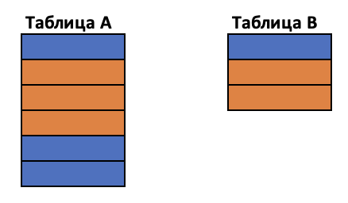

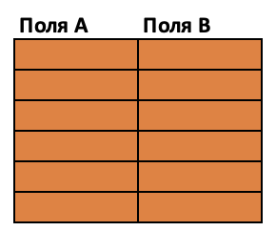
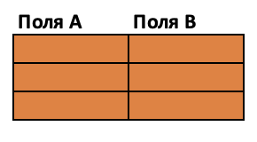
Options of outer join
By condition A.id_a = B.id_a you can find related rows in another table
There are no related rows for condition A.id_a = B.id_a
Possible results of an inner join

Slide 33
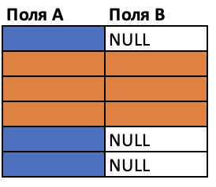
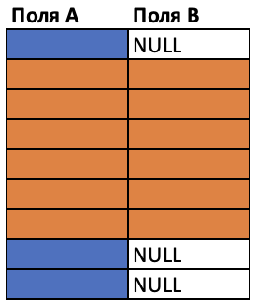
Options of outer join
By condition A.id_a = B.id_a you can find related rows in another table
There are no related rows for condition A.id_a = B.id_a
A LEFT JOIN B
Possible results of an inner join

Slide 34
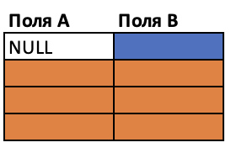
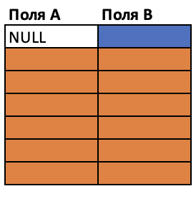
Options of outer join
By condition A.id_a = B.id_a you can find related rows in another table
There are no related rows for condition A.id_a = B.id_a
A RIGHT JOIN B
Possible results of an inner join

Slide 35
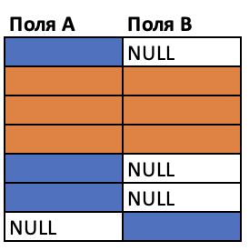
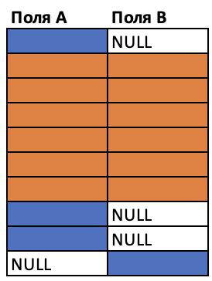
Options of outer join
By condition A.id_a = B.id_a you can find related rows in another table
There are no related rows for condition A.id_a = B.id_a
A FULL JOIN B
Possible results of an inner join

Slide 36
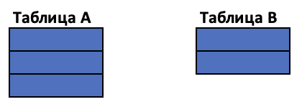
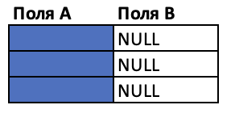
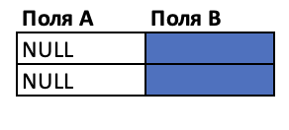
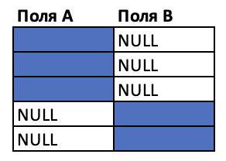
Options of outer join
By condition A.id_a = B.id_a you can find related rows in another table
There are no related rows for condition A.id_a = B.id_a
A LEFT JOIN B
A RIGHT JOIN B
A FULL JOIN B
inner join will return an empty table

Slide 37
Result of outer join
select * from A LEFT JOIN B on a1 = b1
a1 | a2
1 | 3
2 | 4
NULL | 2
b1 | b2 | b3
1 | 3 | 6
1 | 4 | 7
10 | 5 | 8
1 | 11 | 12
NULL | 4 | 5
A
B
a1 | a2 | b1 | b2 | b3
1 | 3 | 1 | 3 | 6
1 | 3 | 1 | 4 | 7
1 | 3 | 1 | 11 | 12
2 | 4 | NULL | NULL | NULL
NULL | 2 | NULL | NULL | NULL

Slide 38
Result of outer join
select * from A RIGHT JOIN B on a1 = b1
a1 | a2
1 | 3
2 | 4
NULL | 2
b1 | b2 | b3
1 | 3 | 6
1 | 4 | 7
10 | 5 | 8
1 | 11 | 12
NULL | 4 | 5
A
B
a1 | a2 | b1 | b2 | b3
1 | 3 | 1 | 3 | 6
1 | 3 | 1 | 4 | 7
1 | 3 | 1 | 11 | 12
NULL | NULL | 10 | 5 | 8
NULL | NULL | NULL | 4 | 5

Slide 39
Result of outer join
select * from A FULL JOIN B on a1 = b1
a1 | a2
1 | 3
2 | 4
NULL | 2
A
a1 | a2 | b1 | b2 | b3
1 | 3 | 1 | 3 | 6
1 | 3 | 1 | 4 | 7
1 | 3 | 1 | 11 | 12
2 | 4 | NULL | NULL | NULL
NULL | 2 | NULL | NULL | NULL
NULL | NULL | 10 | 5 | 8
NULL | NULL | NULL | 4 | 5
b1 | b2 | b3
1 | 3 | 6
1 | 4 | 7
10 | 5 | 8
1 | 11 | 12
NULL | 4 | 5
B

Slide 40
How many rows?
Given two tables
Table A contains X records
Table B contains Y records
SELECT * from A left join B on A.id = B.id_a
How many rows can this query return? Need to estimate lower and upper bounds

Slide 41
How many rows?
Given two tables
Table A contains X records
Table B contains Y records
SELECT * from A left join B on A.id = B.id_a
How many rows can this query return? Need to estimate lower and upper bounds
Not less than X, not more than X * Y

Slide 42
How many rows?
Given two tables
Table A contains X records
Table B contains Y records
SELECT * from A right join B on A.id = B.id_a
How many rows can this query return? Need to estimate lower and upper bounds

Slide 43
How many rows?
Given two tables
Table A contains X records
Table B contains Y records
SELECT * from A right join B on A.id = B.id_a
How many rows can this query return? Need to estimate lower and upper bounds
Not less than Y, not more than X * Y

Slide 44
How many rows?
Given two tables
Table A contains X records
Table B contains Y records
SELECT * from A full join B on A.id = B.id_a
How many rows can this query return? Need to estimate lower and upper bounds

Slide 45
How many rows?
Given two tables
Table A contains X records
Table B contains Y records
SELECT * from A full join B on A.id = B.id_a
How many rows can this query return? Need to estimate lower and upper bounds
Not less than min(X, Y), not more than X * Y

Slide 46
Question
How many rows will a left join query return if the condition is always false?
SELECT * FROM A LEFT JOIN B ON 1 = 0

Slide 47
Question
How many rows will a left join query return where the condition is always true?
SELECT * FROM A LEFT JOIN B ON 1 = 1

Slide 48
Errors in condition in join operator

Slide 49
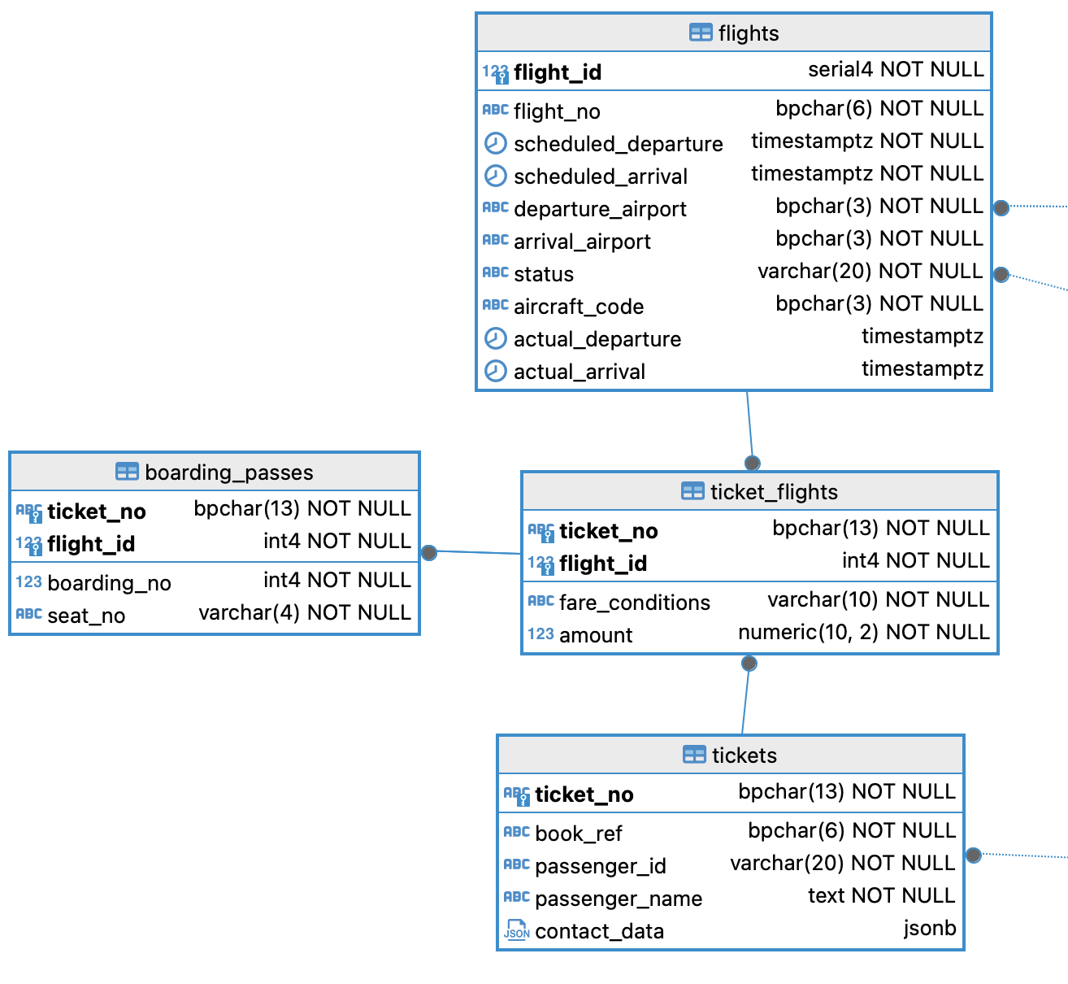
Example of using INNER JOIN
Need to find all boarding passes for flight PG0109, which was operated on 2017-05-14
This database stores data about air transportation
boarding_passes – boarding passes
flights
tickets
ticket_flights – flights in one ticket

Slide 50
Example of using INNER JOIN
Need to find all boarding passes for flight PG0109, which was operated on 2017-05-14
This database stores data about air transportation
boarding_passes – boarding passes
flights
tickets
ticket_flights – flights in one ticket
Flight number
Boarding passes
Fate conditions

Slide 51
Example of using INNER JOIN
Need to find all boarding passes for flight PG0109, which was operated on 2017-05-14
select
flight_id,
flight_no,
scheduled_departure
from flights f
where
f.flight_no = 'PG0109'
and f.scheduled_departure >= '2017-05-14'
and f.scheduled_departure < '2017-05-15';
This query will find the flight you need.

Slide 52
Example of using INNER JOIN
Need to find all boarding passes for flight PG0109, which was operated on 2017-05-14
Add boarding passes to the flight with the found flight_id
with fl as (select
flight_id
from flights f
where
f.flight_no = 'PG0109'
and f.scheduled_departure >= '2017-05-14'
and f.scheduled_departure < '2017-05-15'
)
select bp.flight_id, bp.boarding_no, bp.seat_no
from fl
join boarding_passes bp
on fl.flight_id = bp.flight_id;

Slide 53
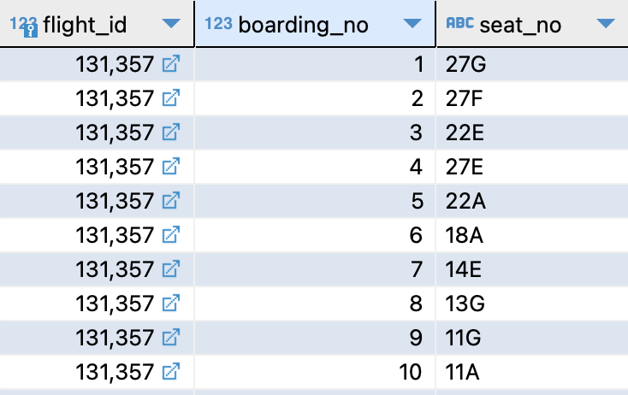
Example of using INNER JOIN
with fl as (select
flight_id
from flights f
where
f.flight_no = 'PG0109'
and f.scheduled_departure >= '2017-05-14'
and f.scheduled_departure < '2017-05-15'
)
select
bp.flight_id,
bp.boarding_no,
bp.seat_no
from fl
join boarding_passes bp
on fl.flight_id = bp.flight_id;
Total 32 boarding passes
This request is missing service conditions (economy, business).
The conditions are in the ticket_flights table

Slide 54
Example of using INNER JOIN
with fl as (select
flight_id ....
)
select
bp.flight_id,
bp.boarding_no,
bp.seat_no,
tf.fare_conditions
from fl
join boarding_passes bp
on fl.flight_id = bp.flight_id
join ticket_flights tf
on tf.flight_id = bp.flight_id

Slide 55
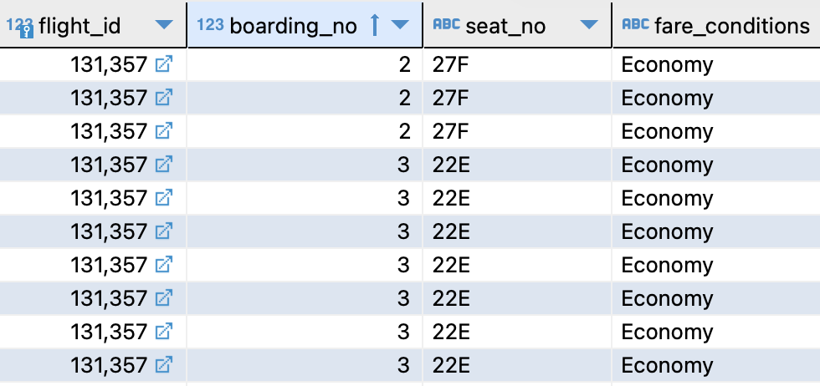
Example of using INNER JOIN
with fl as (select
flight_id ...
)
select
bp.flight_id,
bp.boarding_no,
bp.seat_no,
tf.fare_conditions
from fl
join boarding_passes bp
on fl.flight_id = bp.flight_id
join ticket_flights tf
on tf.flight_id = bp.flight_id
Total 1024 lines
But boarding passes – 32 pcs.

Slide 56
Example of using INNER JOIN
with fl as (...
)
select
bp.flight_id,
bp.boarding_no,
bp.seat_no,
tf.fare_conditions
from fl
join boarding_passes bp
on fl.flight_id = bp.flight_id
join ticket_flights tf
on tf.flight_id = bp.flight_id
Total 1024 lines
But boarding passes – 32 pcs.

Slide 57
Example of using INNER JOIN
with fl as (select
...)
select
bp.flight_id,
bp.boarding_no,
bp.seat_no,
tf.fare_conditions
from fl
join boarding_passes bp
on fl.flight_id = bp.flight_id
join ticket_flights tf
on tf.flight_id = bp.flight_id
In boarding_passes and in ticket_flights for one flight_id value, you can find many rows
You need to create a condition that will find one row with conditions for each boarding pass

Slide 58
Example of using INNER JOIN
Adding ticket_id to the join clause fixes the problem
flight_id & ticket_id define the primary key of the boarding pass and the flight in the ticket
one combination of flight_id & ticket_id is guaranteed to find no more than 1 row in either table
the condition on these fields will not select extra rows
with fl as (select
...)
select
bp.flight_id,
bp.boarding_no,
bp.seat_no,
tf.fare_conditions
from fl
join boarding_passes bp
on fl.flight_id = bp.flight_id
join ticket_flights tf
on tf.flight_id = bp.flight_id
and tf.ticket_no = bp.ticket_no

Slide 59
Example of using INNER JOIN
with fl as (select
...)
select
bp.flight_id,
bp.boarding_no,
bp.seat_no,
tf.fare_conditions
from fl
join boarding_passes bp
on fl.flight_id = bp.flight_id
join ticket_flights tf
on tf.ticket_no = bp.ticket_no
This query is also incorrect
Instead of 32 lines - 128 records
One ticket can include several flights

Slide 60
Example of using INNER JOIN
You should check the number of rows in the query result with join
If the number of rows is incorrect, then you need to check the conditions in join
If the join condition uses the primary key of one of the tables, then most likely you will not encounter the problem of extra records

